Slide 1
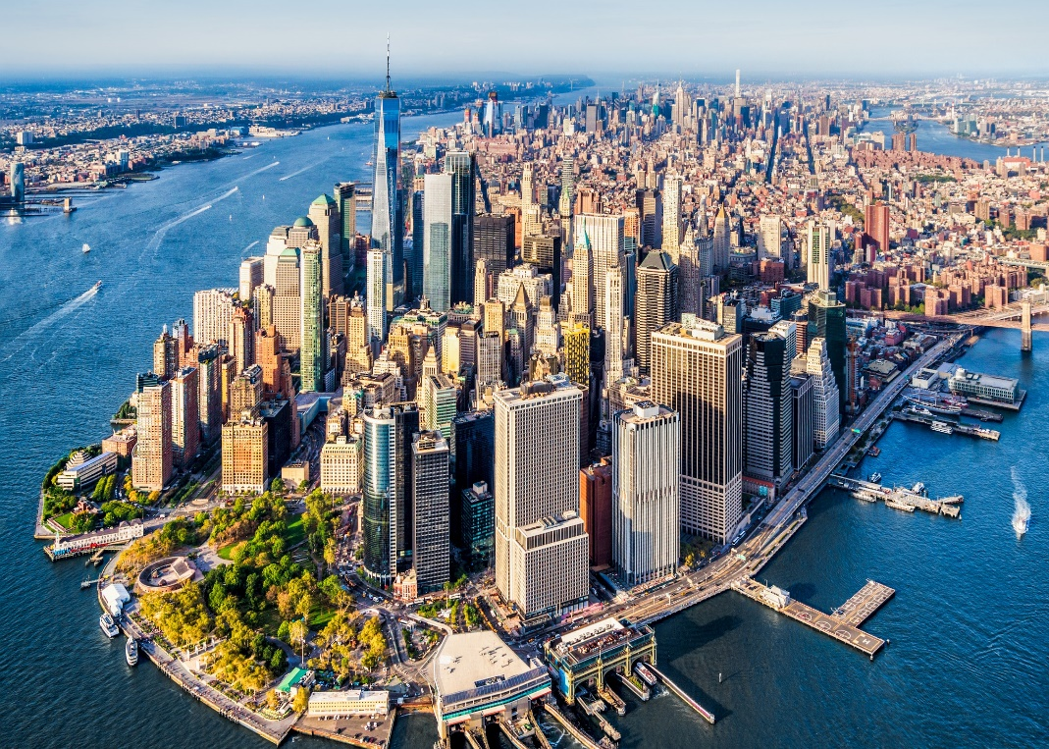
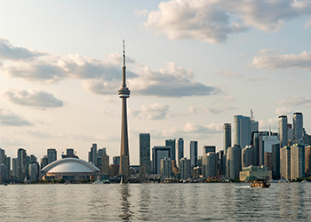
Clustering the Neighborhoods of New York City and Toronto
Soumya Ranjan Behera

Slide 2
Introduction
We will be studying about the neighborhoods of two of most multicultural and cosmopolitan cities in the world: New York City (NYC), United States of America and Toronto, Canada and cluster them into groups with similar traits. The clustering will be based on the types (categories) of venues in the neighborhoods.
Doing this project will enable us to get a better understanding of similarities and differences between the two cities which will make it known to business people what types of businesses are more likely to thrive in both cities, what are the neighborhoods that are suitable for each type of business, and what types of businesses are not very desirable in each city. This allows business people to take better and more effective decisions regarding where to open their businesses.

Slide 3
Data Acquisition
Neighborhood Data: Lists the names of the neighborhoods of NYC and Toronto and their latitude and longitude coordinates. NYC neighborhood data was provided through the "IBM Data Science Professional Certificate" course in the form of a JSON file and for Toronto, we scraped the data from a Wikipedia page
(https://en.wikipedia.org/wiki/List_of_postal_codes_of_Canada:_M).
Venues Data: Lists the top venues (restaurants, cafes, parks, museums, etc.) in each neighborhood of the two cities. This data was retrieved from Foursquare API.

Slide 4
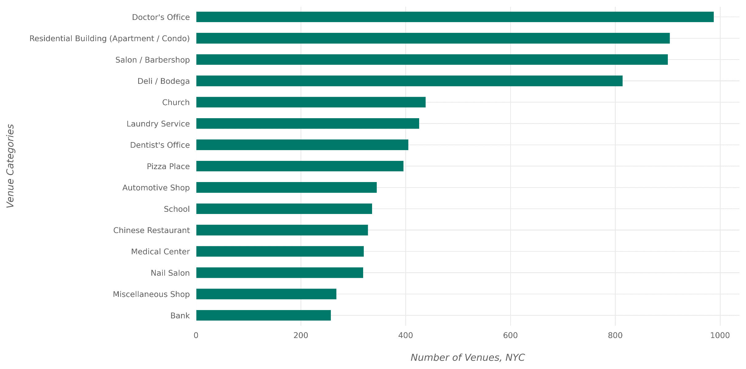
Most Common Venue Categories in NYC

Slide 5
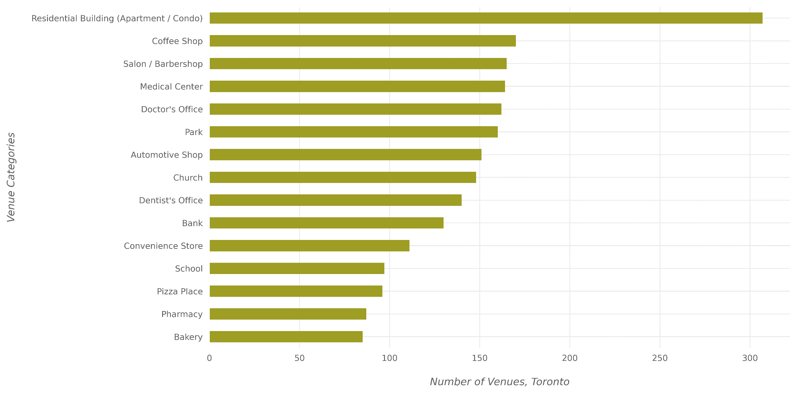
Most Common Venue Categories in Toronto

Slide 6
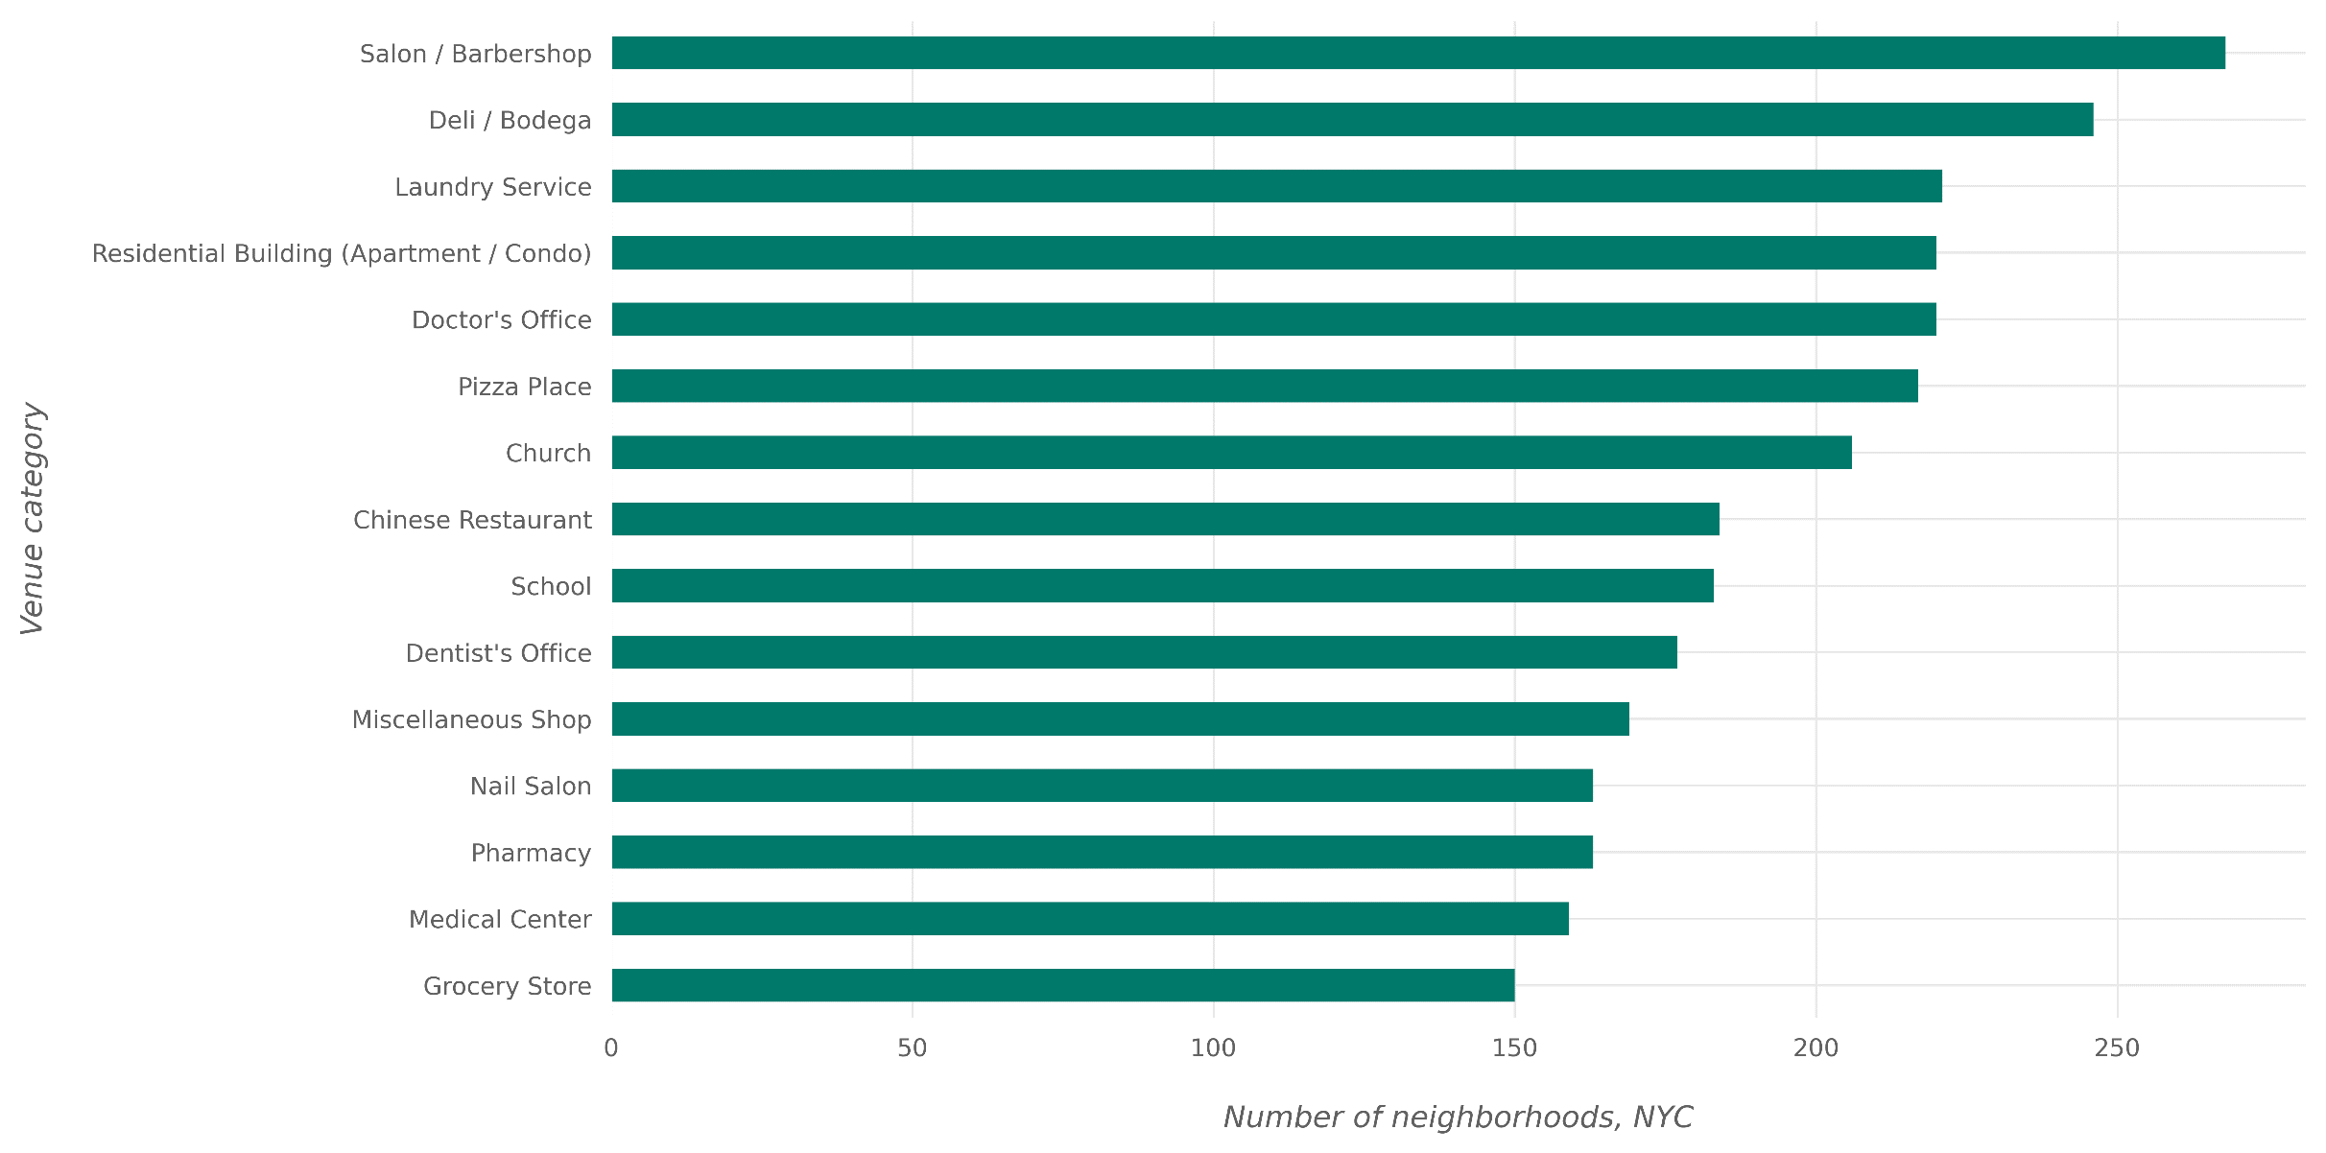
Most Widespread Venue Categories in NYC

Slide 7
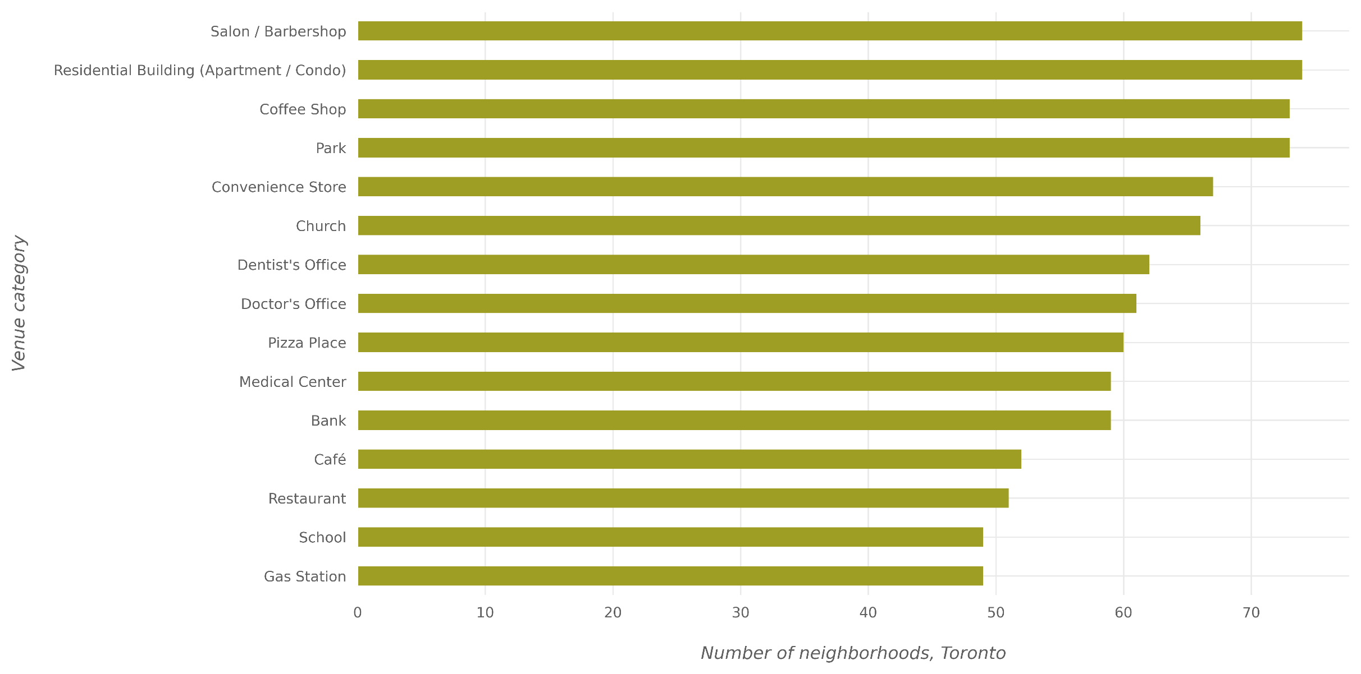
Most Widespread Venue Categories in Toronto

Slide 8
Clustering of Neighborhoods
The goal of the clustering is to cluster neighborhoods based on the similarity of venue categories in the neighborhoods. Thus, we selected those two features from the dataset, i.e., “Neighborhood” and “Venue Category”.
For the clustering algorithm to work, the categorical values needs to be converted into numerical features. One-hot encoding is applied on the “Venue Category” feature and the result of the encoding was used for our clustering algorithm.
K-Means algorithm was utilized to cluster the neighborhoods into similar groups and the number of clusters to divide the neighborhoods into is chosen to be five.

Slide 9
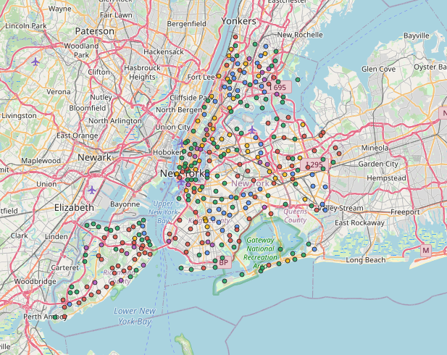
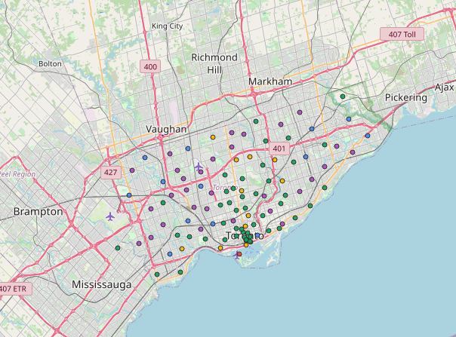
Map of NYC and Toronto with its Neighborhoods
The neighborhoods of both NYC and Toronto have been clustered into five groups and are represented on the below map by different colors with each color indicating a separate group.
NYC
Toronto

Slide 10
Cluster Analysis
Some of the rarest categories we could find in the dataset are Paintball Field, Baggage Locker, Hot Spring, Burmese Restaurant, Sausage Shop, Indian Sweet Shop, Buddhist Temple and Caucasian Restaurant among others.
Total number of neighborhoods in each cluster
Cluster Label | Total Neighborhoods
0 | 31
1 | 46
2 | 42
3 | 204
4 | 82

Slide 11
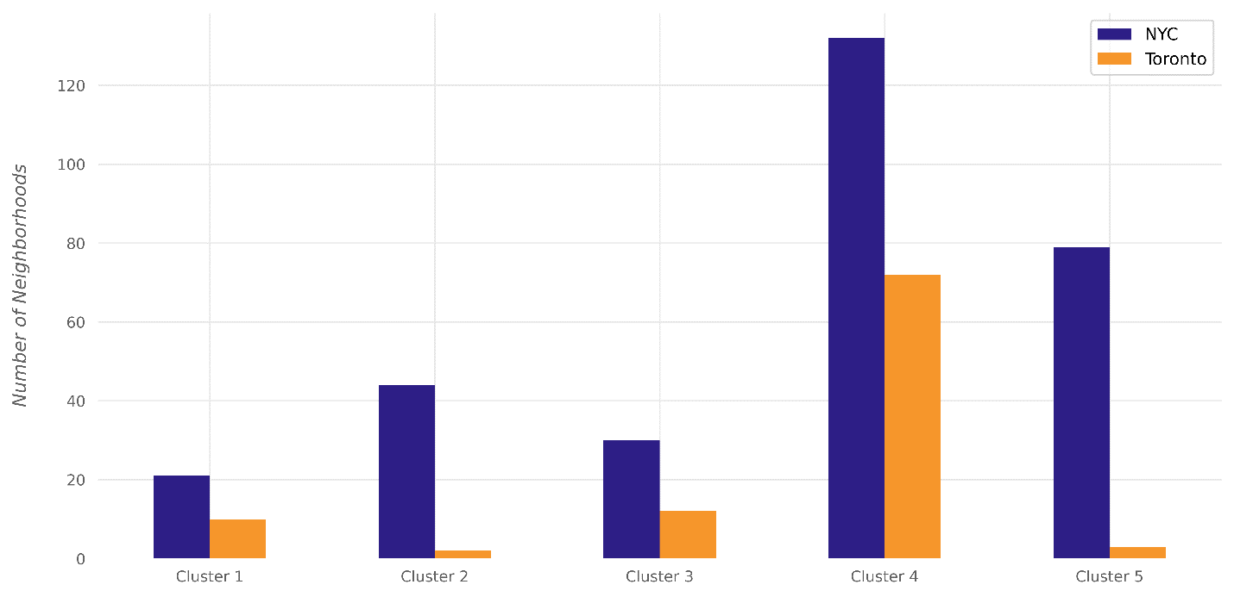
Cluster Analysis
The number of NYC and Toronto neighborhoods in each cluster.

Slide 12
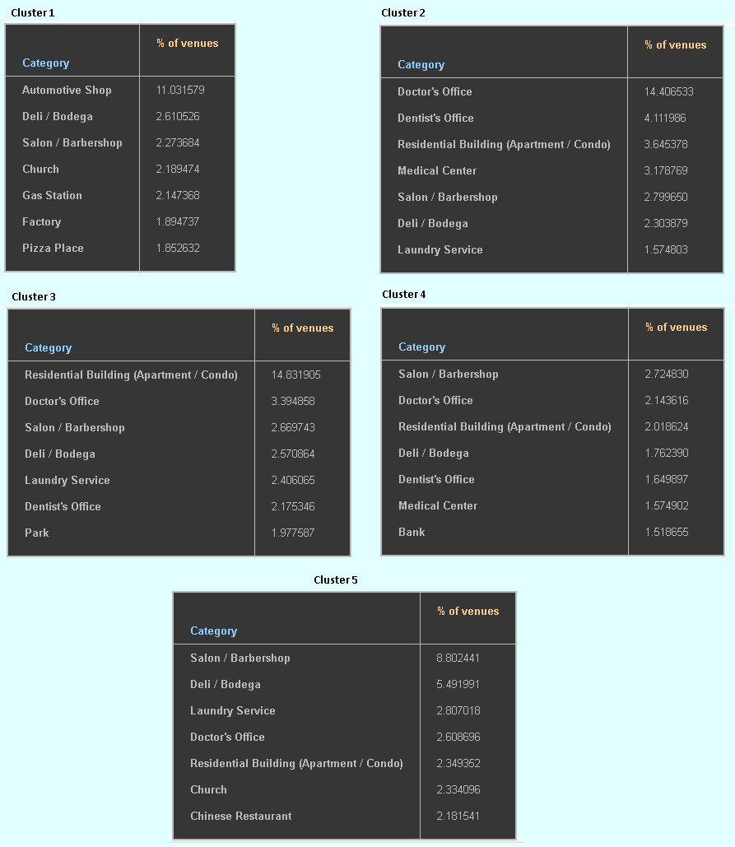
Cluster Analysis
The seven most common venue categories in each cluster and their corresponding percentage of occurrence in the neighborhoods of that particular cluster

Slide 13
Cluster Analysis
While residential buildings constitute 14.83% of venues in the neighborhoods of the third cluster, they constitute 3.6% of the venues in the second cluster, 2.01 % in the third cluster and 2.34% of the venues in the fourth cluster.
Salon/Barbershops appears at the top most common venue categories of the fourth and fifth clusters; along with appearing in the top seven categories of the rest of the clusters.
Doctor’s Office and Dentist’s Office constitutes nearly 18 of the venue categories in the second cluster taking up the top two slots; while their percentages of occurrences in other clusters is not so high comparatively.
Automotive shops is the most popular category for the first cluster; moreover, Automotive Shop appears only in the first cluster.

Slide 14
Conclusion
In this project, the neighborhoods of New York City and Toronto were clustered into multiple groups based on the categories (types) of the venues in these neighborhoods. The results showed that there are venue categories that are more common in some cluster than the others; the most common venue categories differ from one cluster to the other. If a deeper analysis—taking more aspects into account—is performed, it might result in discovering different style in each cluster based on the most common categories in the cluster.

